Slide 1

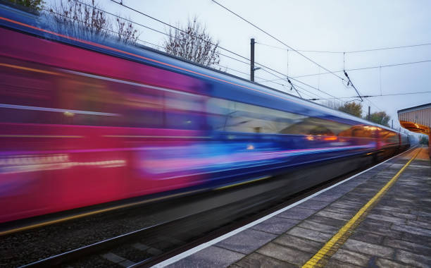
UK Train Rides

Slide 2

Acknowledgement
This project was executed through the collaborative and coordinated efforts of the team members:
- Sara Reda
- Hend Tarek
- Salma Hassan
- Aya Sameh
10

Slide 3
Overview
This project aims to analyze a dataset of UK train ticket purchases to gain insights into passenger behaviour, pricing trends, and operational efficiency.
The dataset includes details such as ticket prices, purchase methods, rail card usage, journey times, and delay information.
By exploring this data, we hope to identify patterns and trends that can inform decision-making related to pricing strategies, service improvements, and resource allocation within the UK rail network.
10

Slide 4

Data Overview
Travel Details
Departure Date
Departure Time
Arrival Time
Actual Arrival Time
Transaction Details
Purchase Type
Payment Method
Refund Request
Departure Station
Arrival Destination
Journey Status
Reason for Delay
Purchase Date
Purchase Time
Transaction ID
Ticket Details
Ticket Class
Ticket Type
Rail Card
Price

Slide 5
Methodology
Data Preprocessing and Modelling
Utilizing Python libraries like Pandas and Matplotlib for initial data refinement and Structuring and querying data effectively using SQL for deeper analysis.
Forecasting
Applying Python (Scikit-learn) for predictive insights into future trends.
2nd Phase
4th Phase
1st Phase
3rd Phase
Exploratory Data Analysis
Interactive Visualisation
Leveraging Python (Pandas, Matplotlib, Seaborn) and SQL to thoroughly explore the dataset and uncover hidden patterns.
Creating dynamic dashboards and reports using Tableau for actionable insights.

Slide 6
Data Preprocessing
10

Slide 7
Preprocessing
Data Types
Categorical Labels were standardized
Missing Values
Structurally valid nulls were found and handled accordingly in the fields such as Railcard, Actual Arrival Time, and Reason for Delay
Duplicates
No Duplicate Records Found
Date and Time Fields were converted from objects to the appropriate type
Date and Time Features were added
No Duplicate Primary Keys Found
Your logo

Slide 8
Data Modelling
10

Slide 9
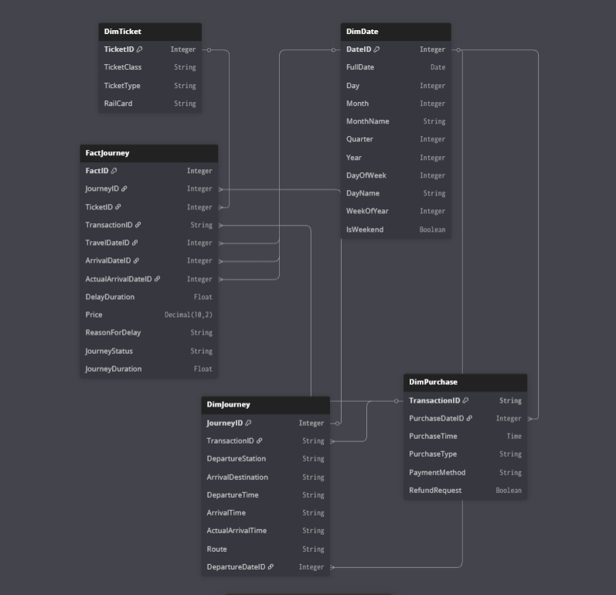
The SQL data modelling process began with the creation of a staging table (railway_data) to store and validate the raw railway dataset.
The staging table served as the foundation for testing data integrity, ensuring accurate data transformation, and verifying that all records were correctly imported and structured before proceeding with the modelling steps.
Once validated, dimension tables were created to normalize the data, while a central fact table was built to link these dimensions with core business metrics.
Comprehensive tests were then performed to confirm that all data relationships, values, and constraints were correctly maintained, ensuring a reliable and scalable data model for analysis.
9

Slide 10
Exploratory Data Analysis
10

Slide 11
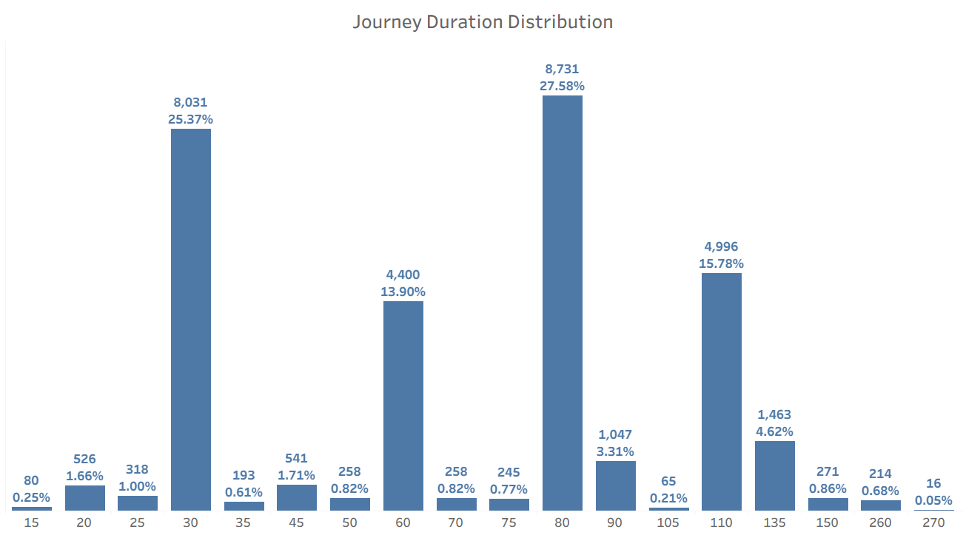
Journey Characteristics
The Top 5 Popular Stations were found to have around 78% of total rides with the most popular station being Birmingham New Street with 15.6% of total rides
The Top 5 popular Routes were found to have around 73% of total rides with the most popular route being Manchester Piccadilly » Liverpool Lime Street with 16.82% of total Rides
27.58% of rides were found to have a Duration of 80 minutes
Peak hours were found to be mostly on weekdays between 6-8am and 4-6pm

Slide 12
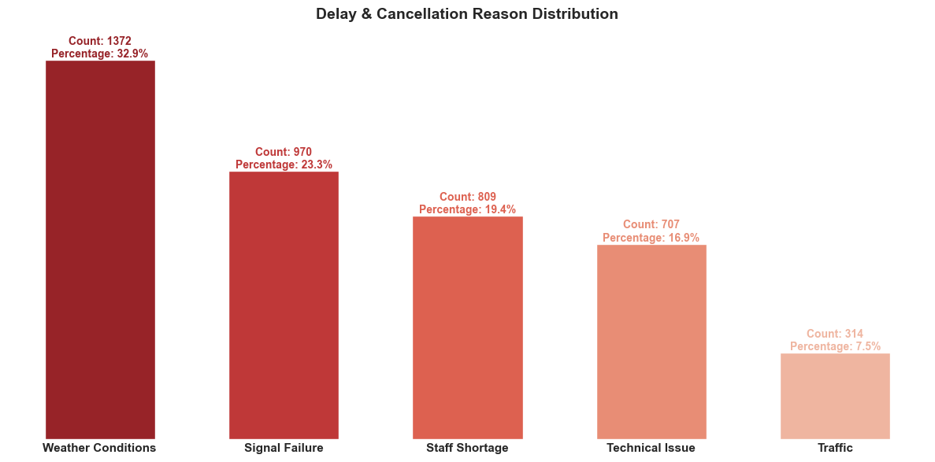
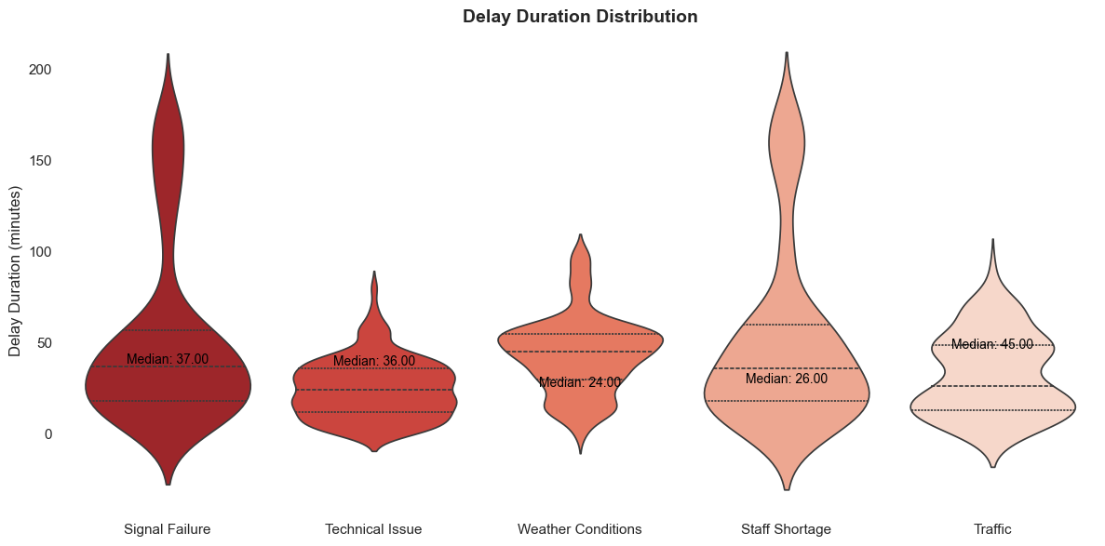
Operational Performance
86.82% were On Time with a delay rate of 7.24% and a Cancellation rate of 5.94% of total rides .
The Most Common Reason for Cancellation was found to be Signal Failure contributing to 27.6% of total Cancellations while Weather Conditions contributed to 40.4% of delays.
Technical Issues and Staffing Shortages were found to have the highest average delay duration of around 51.81 and 51.18 minutes .
Delays were found to mostly occur to Late Morning rides (8 a.m.–11 a.m.) while Night rides (8 p.m.–11 p.m.) had 100% on-time performance.
Cancellations usually peaked towards the end of peak hours (8 a.m. and 5:00 p.m.)

Slide 13
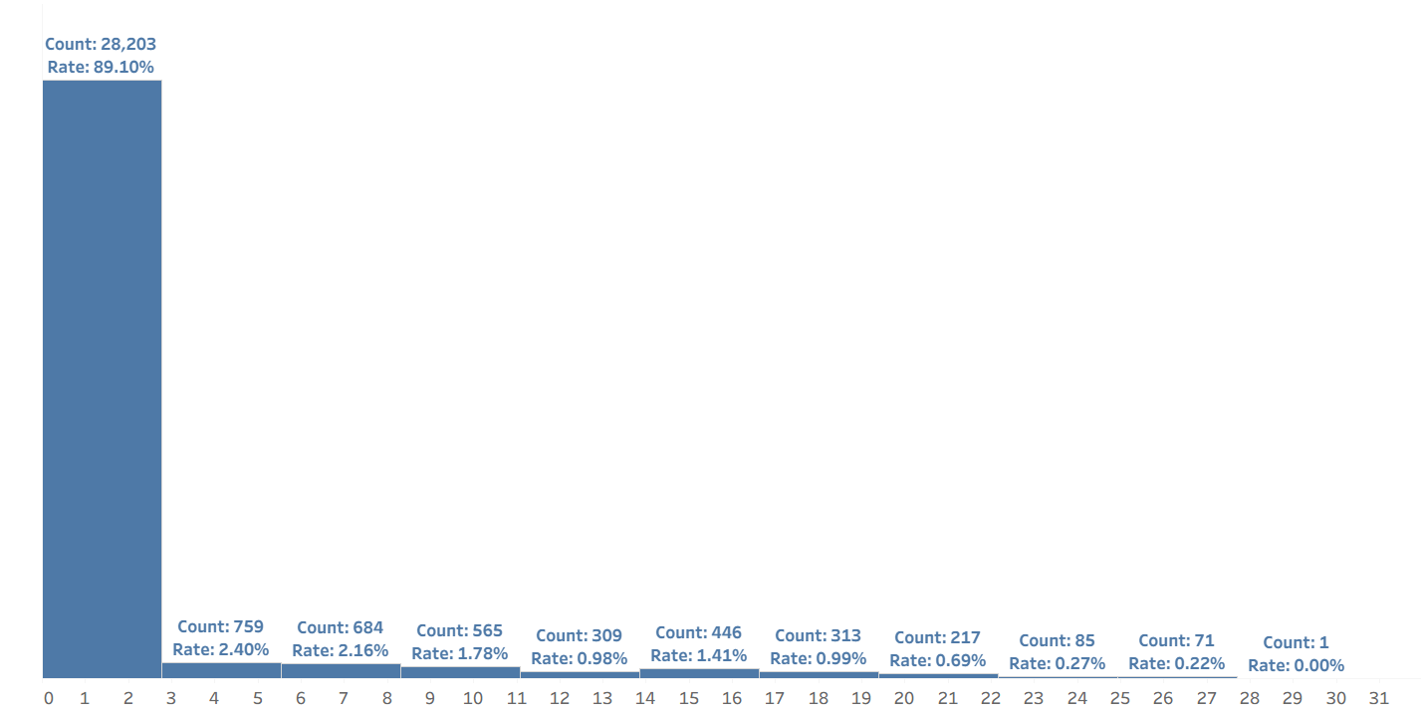
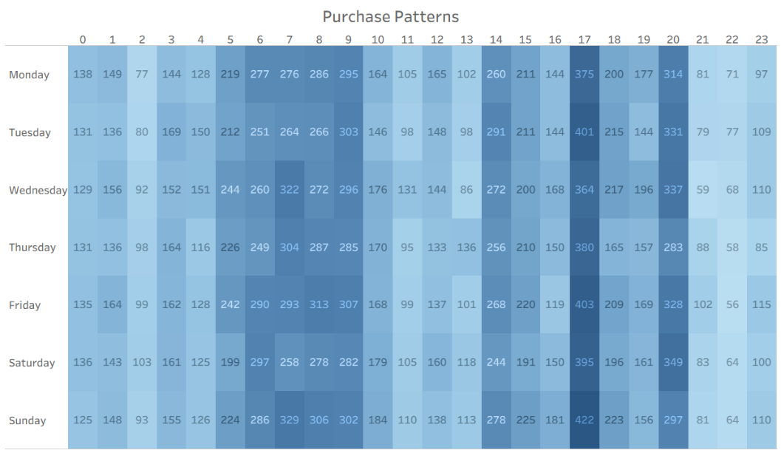
Passenger Behaviour
Purchase Lead Time was around 89.10% for 0-3 days to departure of total Purchases
Advance Tickets are the most popular at 55.5% of total purchases as they offer a 50% discount for tickets purchased at least a day before departure followed by the Off-Peak Tickets at 27.6% which offers 25% off departures outside of peak travel times.
Standard Class Tickets were naturally contributing to the majority of the total purchases at 90.3% while First Class Tickets were at 9.7% .
The most preferred Payment Method was found to be Credit Card at 60.5% of total purchases while the most preferred purchase method was online at 58.5%.
National Railcard holders were found to be contributing to around 33.9 % of total purchases and are mostly adults contributing to around 45.1 % of purchases.

Slide 14
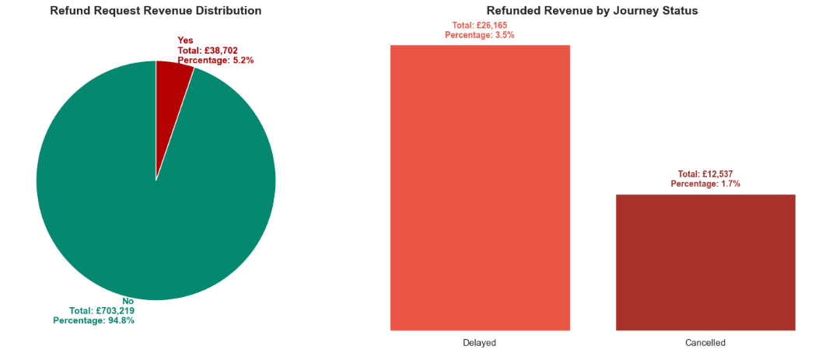
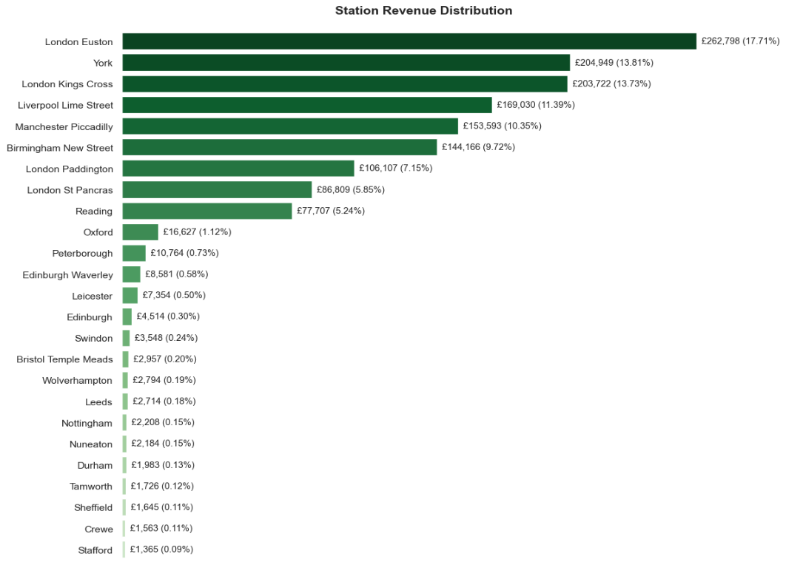
Revenue Trends
Advance Tickets were found to contribute to 41.7% of total revenue while Off-Peak Tickets contributed to 30.1%.
Standard Class Tickets were naturally contributing to the majority of the total revenue at 79.9%.
National Railcard holders contribute to around 22.7 % of total revenue are mostly adults contributing to around 11.6 % of total revenue.
Refund requests in total amount to 5.2% of the total revenue with delays contributing to 3.5% and cancellations to 1.7% of total revenue.

Slide 15
Forecasting
10

Slide 16
Forecasting Methodology
Feature Engineering was done to strengthen the accuracy of models such as adding a dayofweek (Monday = 0) feature in addition to lag features
The dataset was split into a Training set and an Evaluation set with the evaluation set being the last 30 days of the dataset
The Linear Regression Model showed an accuracy of 65% while the random forest regressor showed an accuracy of 82%

Slide 17

Forecasting Insights
Wednesday showed higher ride count of 268 Rides Per week and a revenue of 113,802 £
Peak Rides : Mid month, start of the week, end of the week
Demand was found to not be affected by ticket price increase of 5%
Standard class tickets were found to generate higher revenue at while the First class 20.1%
5% increase in ticket prices was found to affect the total revenue of 193,559.86 £ And increase it up to 203,237.85 £

Slide 18
Interactive Visualisation
10

Slide 19
Visualisation Methodology
Interactive Exploration: A Tableau dashboard was designed specifically to enables stakeholders to dynamically investigate operational performance across stations, routes, and time periods (dates/weekdays) without technical expertise.
Multi-Dimensional Analysis: Users can filter and drill down from system-wide trends to granular, station-specific issues, identifying patterns and anomalies in real time.
Data-Driven Strategy: The tool supports evidence-based decision-making by allowing stakeholders to test hypotheses, validate assumptions, and build strategies grounded in contextualized operational insights.

Slide 20
Conclusion
10

Slide 21
Recommendations Investigate late morning rides for potential delays and implement solutions to improve on-time performance. Address technical difficulties and staffing issues to reduce delays and cancellations. Implement rigorous routine maintenance schedule at all high demand stations in order to withstand harsh weather conditions and avoid technical issues. Focus on Standard Class and popular routes for revenue optimization. Monitor seasonal trends and implement strategies to stabilize revenue during fluctuating months. Address technical difficulties and staffing issues to recover $24,293 (92%) of the revenue loss due to delays.

Slide 22


THANK YOU

